Slide 1
CONTINUOUS SIGN LANGUAGE RECOGNITION
Presented by:
V.Vineela [Y20ACS581]
T.Bhushaiah [Y20ACS576]
R.Vamsi Lakshmi [Y20ACS550]
SK.Roshan Ali [Y20ACS563]
Guide
Mr. K. Ashok Babu Sir
M .Tech., (Ph.D)
Asst. Professor

Slide 2
CONTENTS:
Abstract
Existing system
Proposed system
Design methodology
Implementation
Results
Conclusion

Slide 3
Abstract
Communication is the ability that will influence how effectively human live their personal and professional life. The people with speaking and hearing minority, there is a communication gap between them and other normal people.
Deaf-Dumb people can communicate with normal people with help of sign languages.
Sign Language is a means of communication which involves combining hand shapes, orientations and movement of the hands, arms or body to express the speaker's thoughts.
Sign Language consists of fingerspelling that means each character in a word is spelled out, word level signs, numbers and human relations etc., However it is very difficult for the deaf & dumb people to talk with the ordinary people unless and until ordinary people like us learn the sign language for the purpose of communication. So the proposed system is to translate sign language into words and sentences by using CNN algorithm.

Slide 4
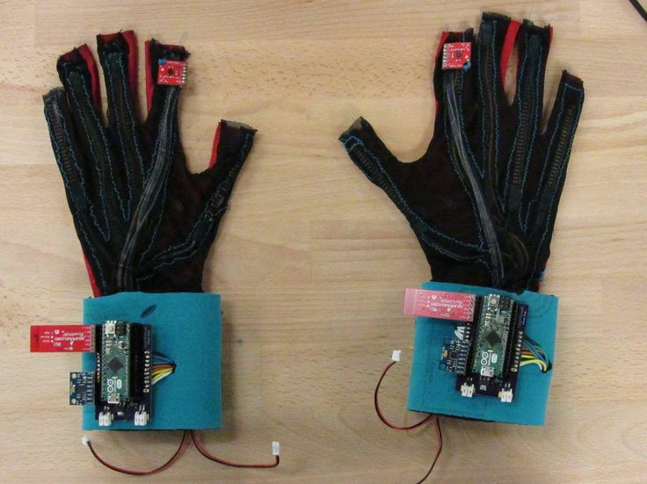
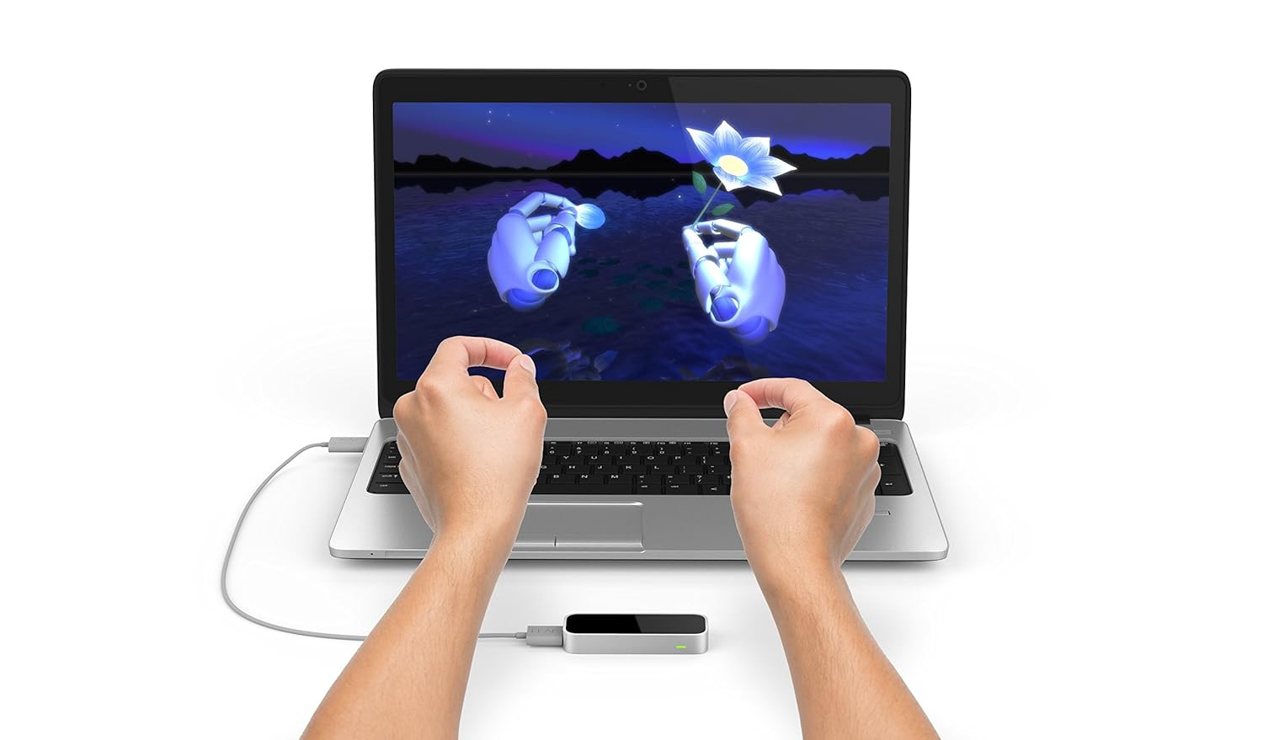
EXISTING SYSTEM
There are some existing systems of Sign Language detection by different image acquisition devices such as Data glove, Kinect and Leap Motion Controller
Different sign language classifiers such as k nearest neighbors, support vector machine, hidden markov model, fuzzy logic and ensemble learning.
LEAP MOTION CONTROLLER
DATA GLOVE

Slide 5
PROPOSED SYSTEM
The proposed system analyses and translate the sign language that is hand gestures into text by using deep learning and also by using OpenCV and Keras modules of python.
We create a sign detector, which detects some signs that can very easily be extended to cover a vast multitude of other signs and hand gestures including the alphabets and it can generate sign for the speech which was given as an input.
This is divided into 3 parts:
Gathering the dataset.
Training a CNN on the captured dataset.
Predicting the data.

Slide 6
DESIGN METHODOLOGY
Image dataset
Preprocessing of image
Feature extraction of image
Classification of extracted image
Prediction interface
Evaluation of result

Slide 7
IMPLEMENTATION
Start
Record the voice
(i) Listen for 1 second and calibrate the energy threshold for ambient noise levels.
(ii) Listen the voice using Microphone.
Now the energy threshold is already set to a good value, and we can reliably catch voice right away.
3. Recognise the voice .
4. Convert Voice to Text.
(i) Make the Text to lowercase for further manipulation.

Slide 8
5. Detected Text
(i)Else if Detected Text in predefined Dictionary Words.
Display respective GIFs of the Phrase.
(ii) Else Count the Letters of the Word/Phrase.
Display the Visual of the phrase with some delay of Actions.
(iii) Continue all the steps from Step 3, and continue till the Speech Ends.
6. If Error in Step 2, That is if no voice Detected then display error message
“Could not listen”.

Slide 9
How to run the application ?
1. Open the Voice to Text or Sign Language Translator folder and then open the terminal.
2. From the terminal, run the “main” python file using the command “streamlit run app.py”.
3. The application interface appears on the screen.
4. Hit the record button to start taking speech as input.
5. Any speech recorded is then processed and respective outputs are shown accordingly.

Slide 10
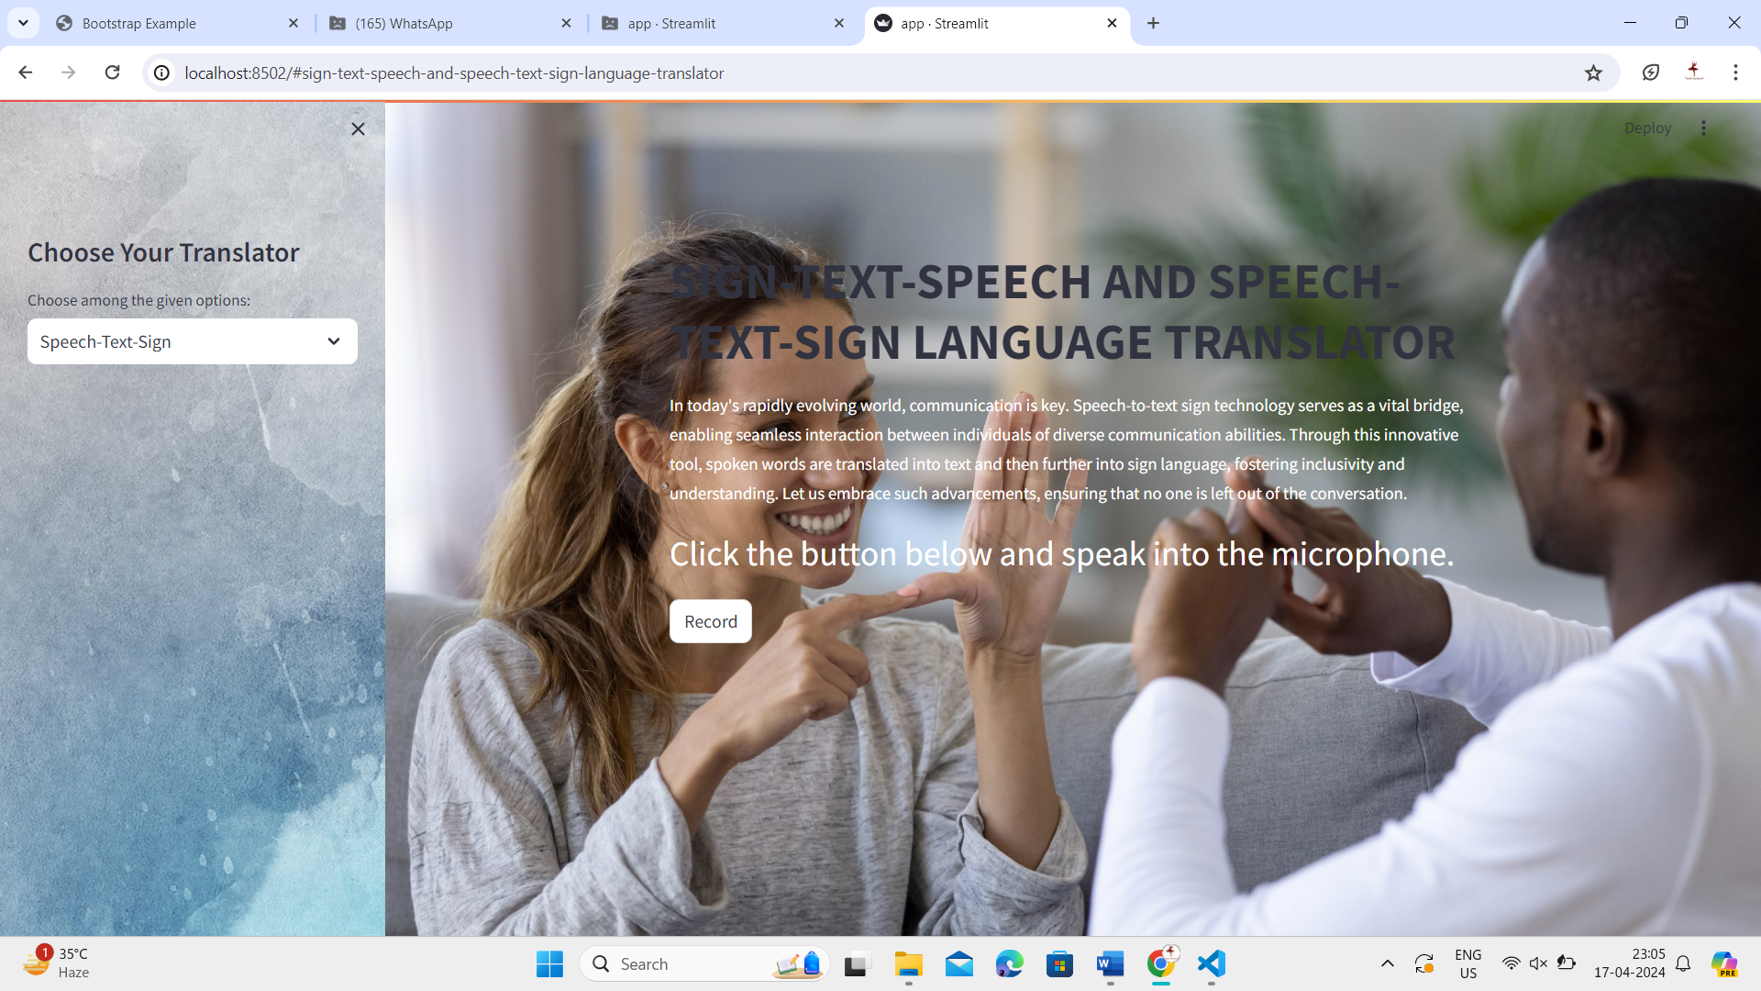
RESULT

Slide 11
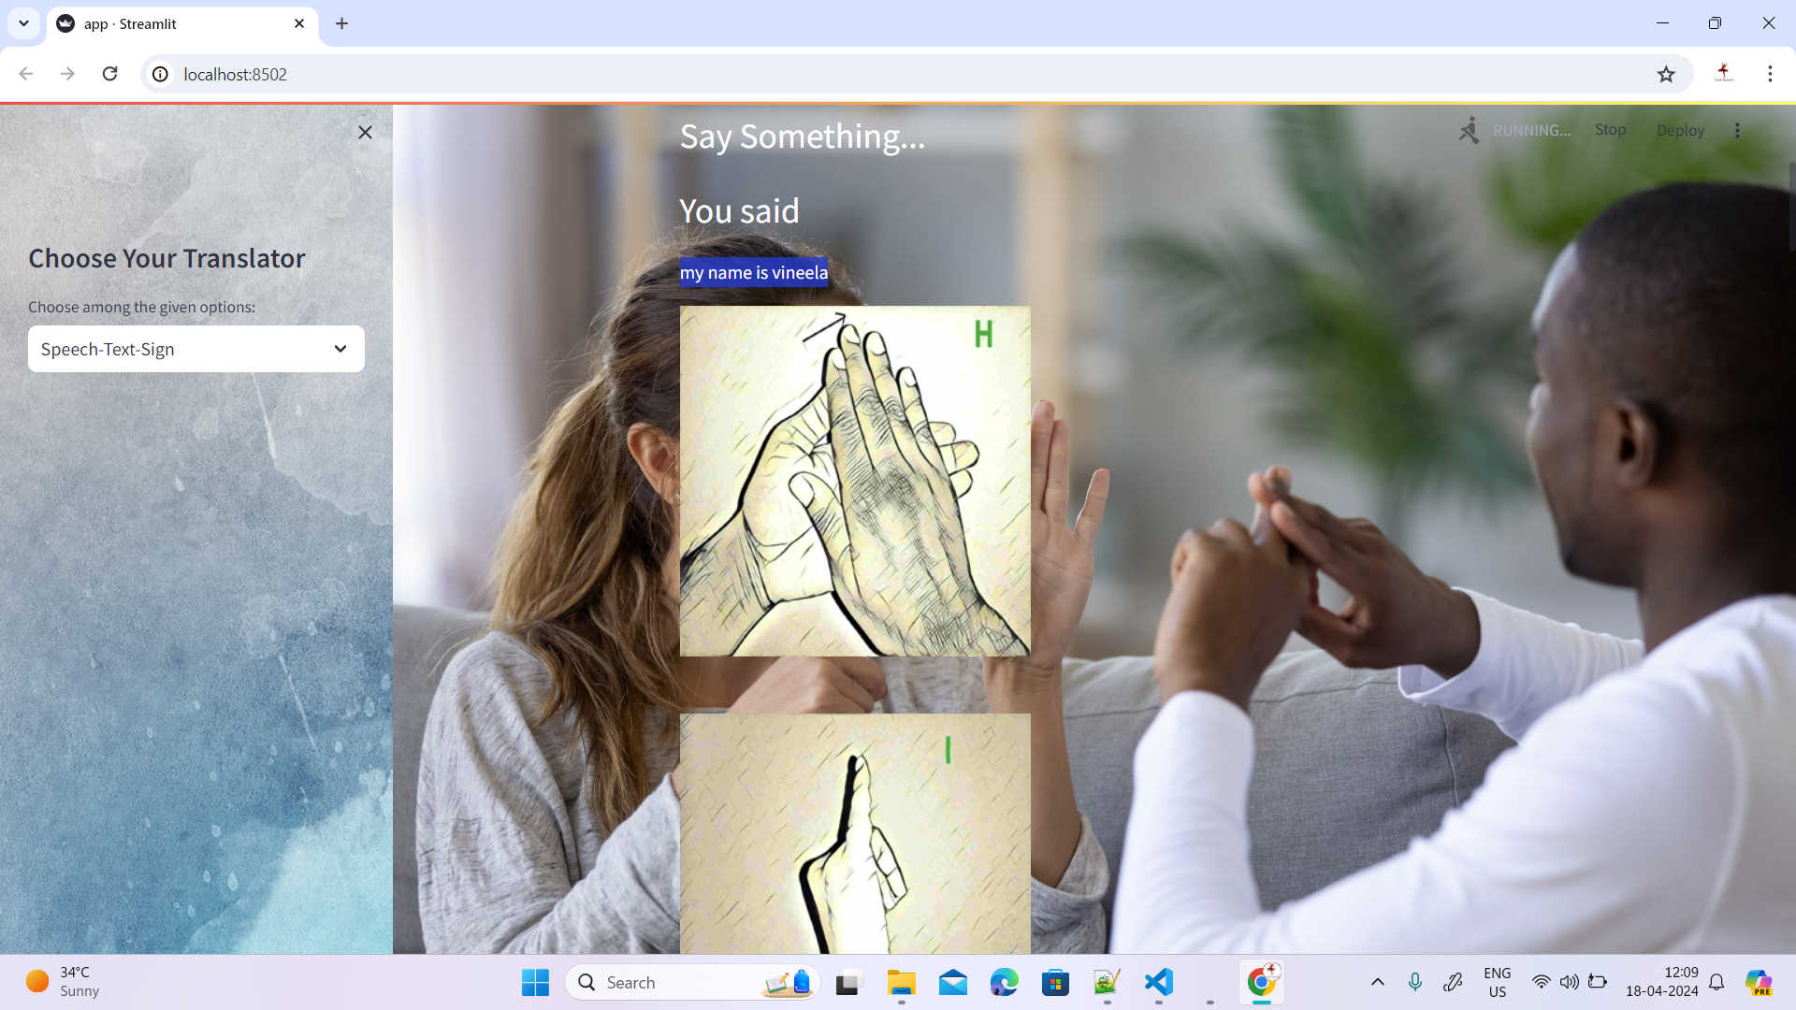

Slide 12
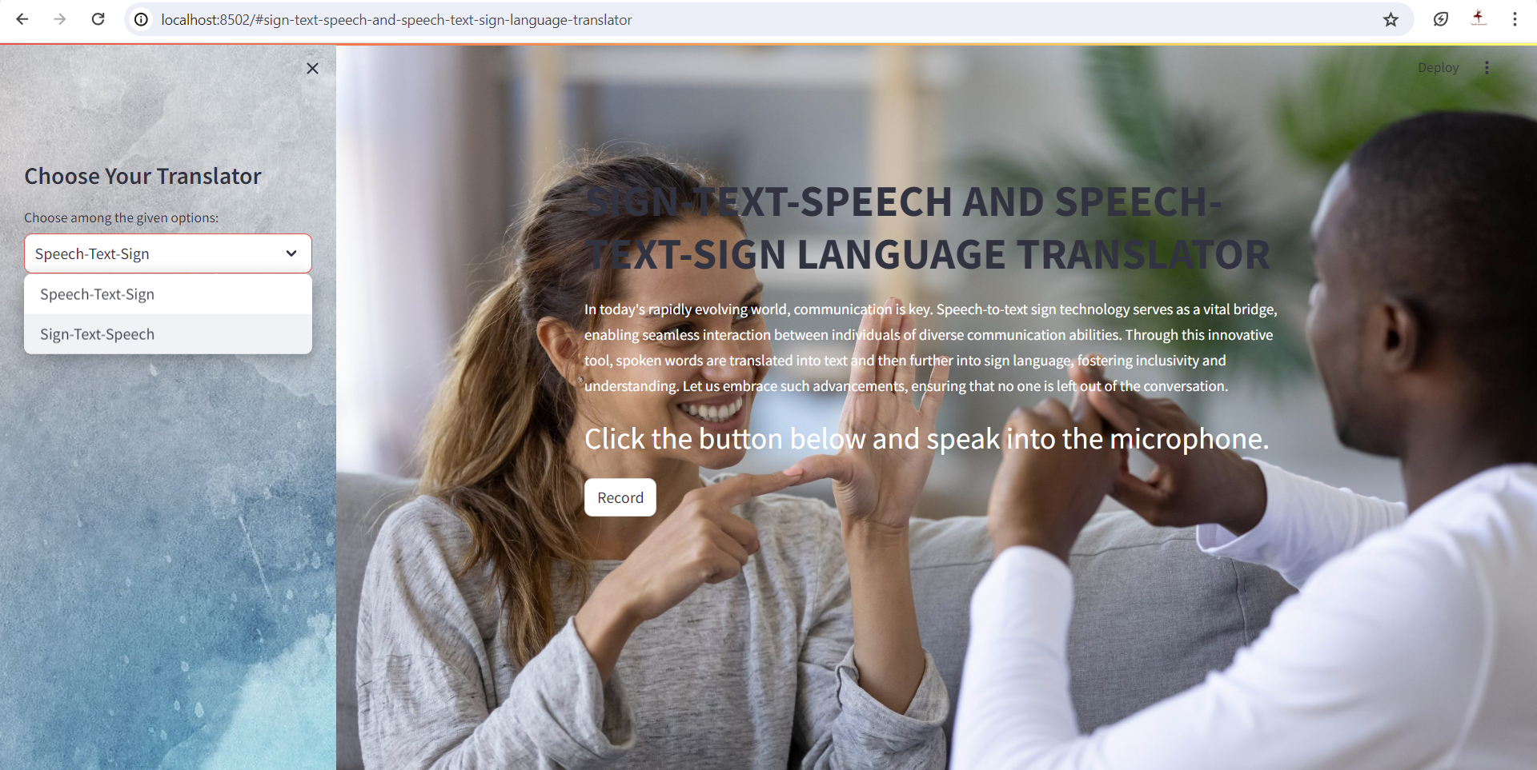

Slide 13
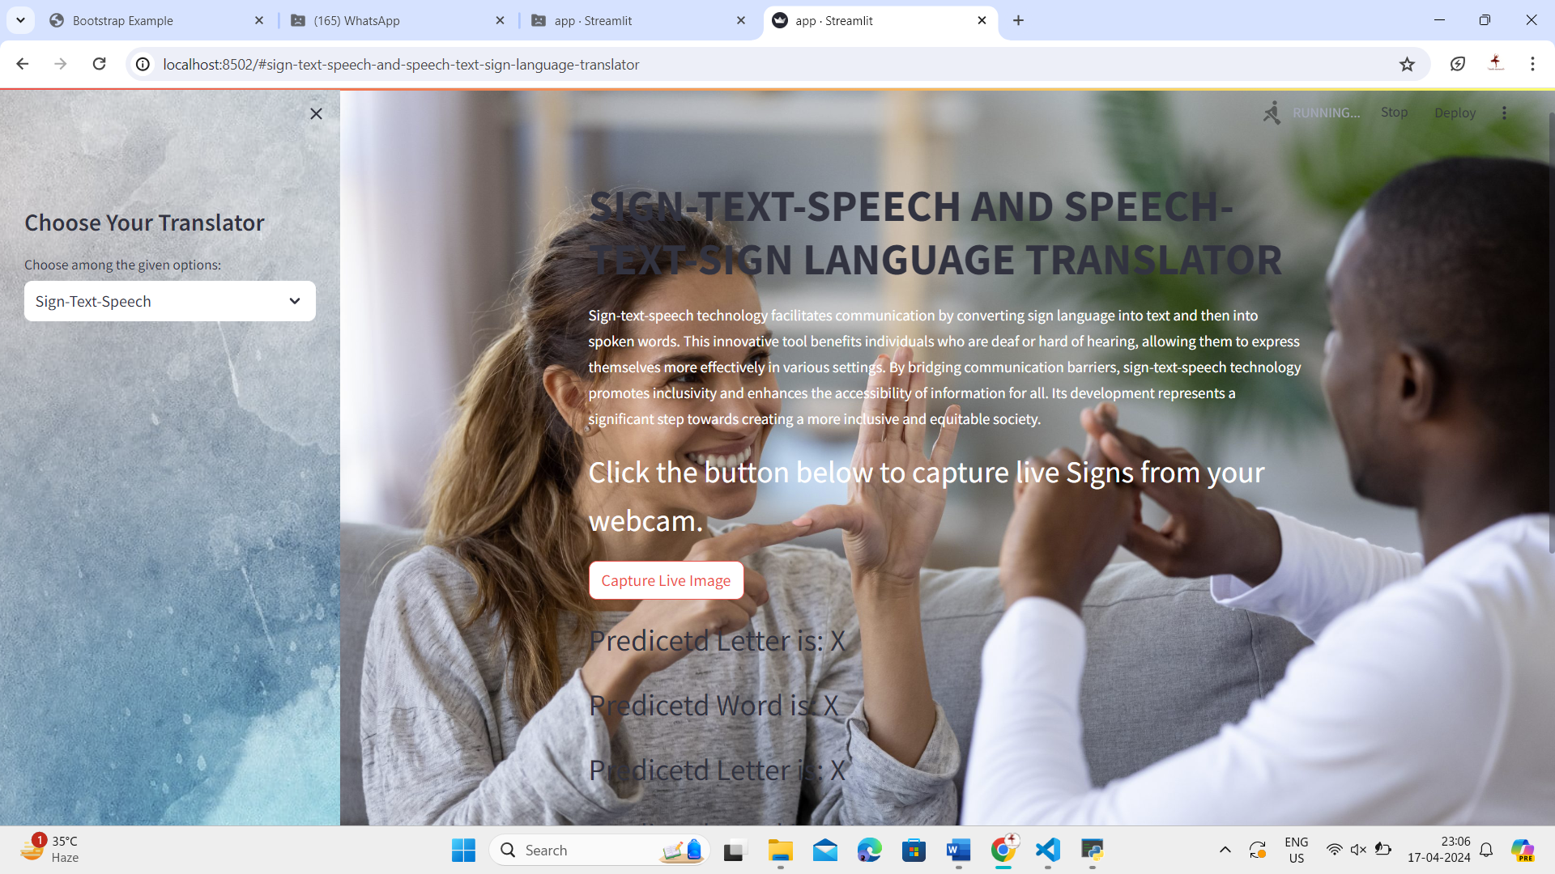

Slide 14
CONCLUSION
Since deaf people are usually deprived of normal communication with other people, they have to rely on an interpreter or some visual communication. Now the interpreter can not be available always, so this project can help eliminate the dependency on the interpreter.
The system can be extended to incorporate the knowledge of facial expressions and body language too so that there is a complete understanding of the context and tone of the input speech.
A mobile and web based version of the application will increase the reach to more people.
Integrating hand gesture recognition system using computer vision for establishing 2-way communication system.

Slide 15
THANK YOU

